Slide 1
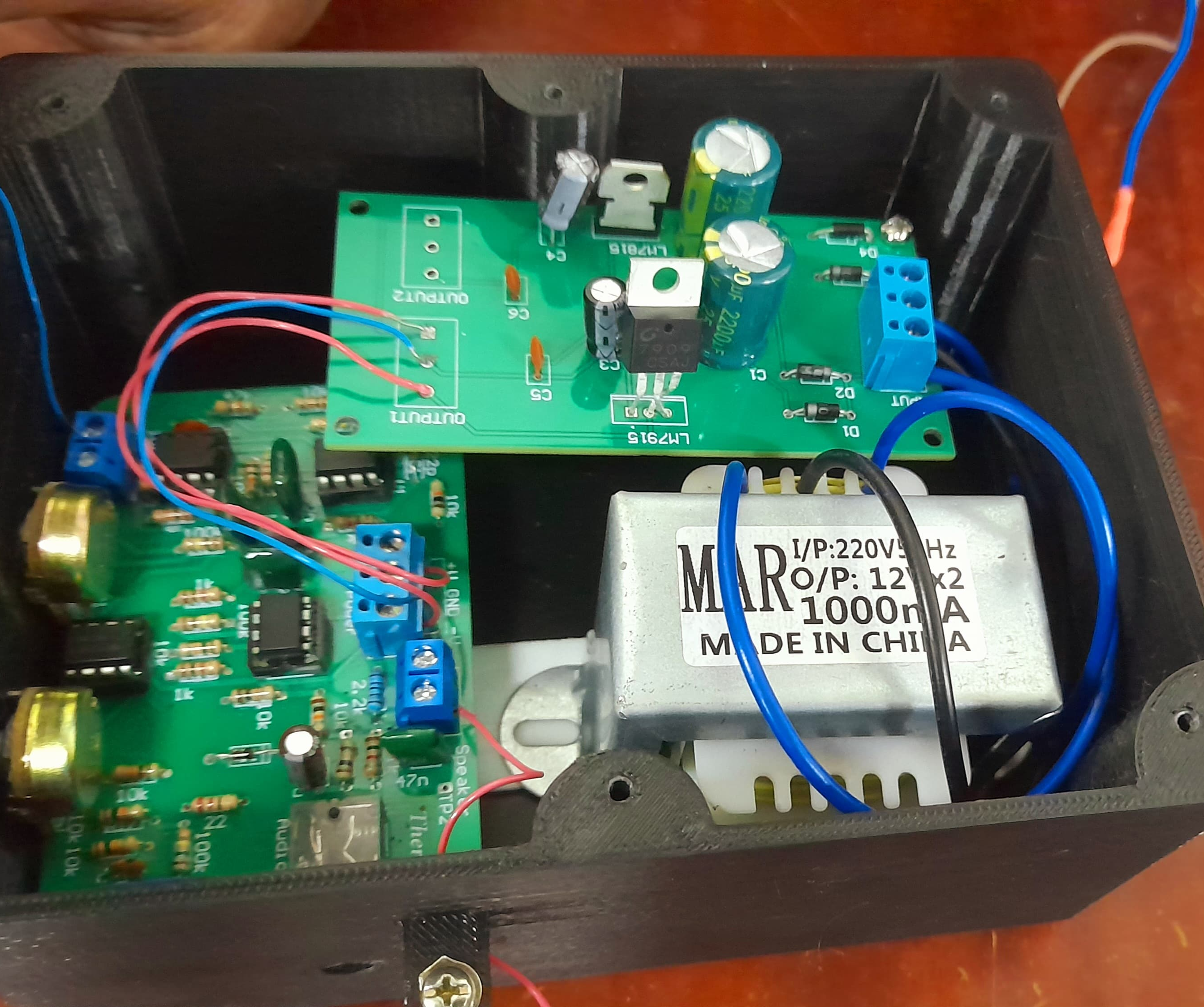
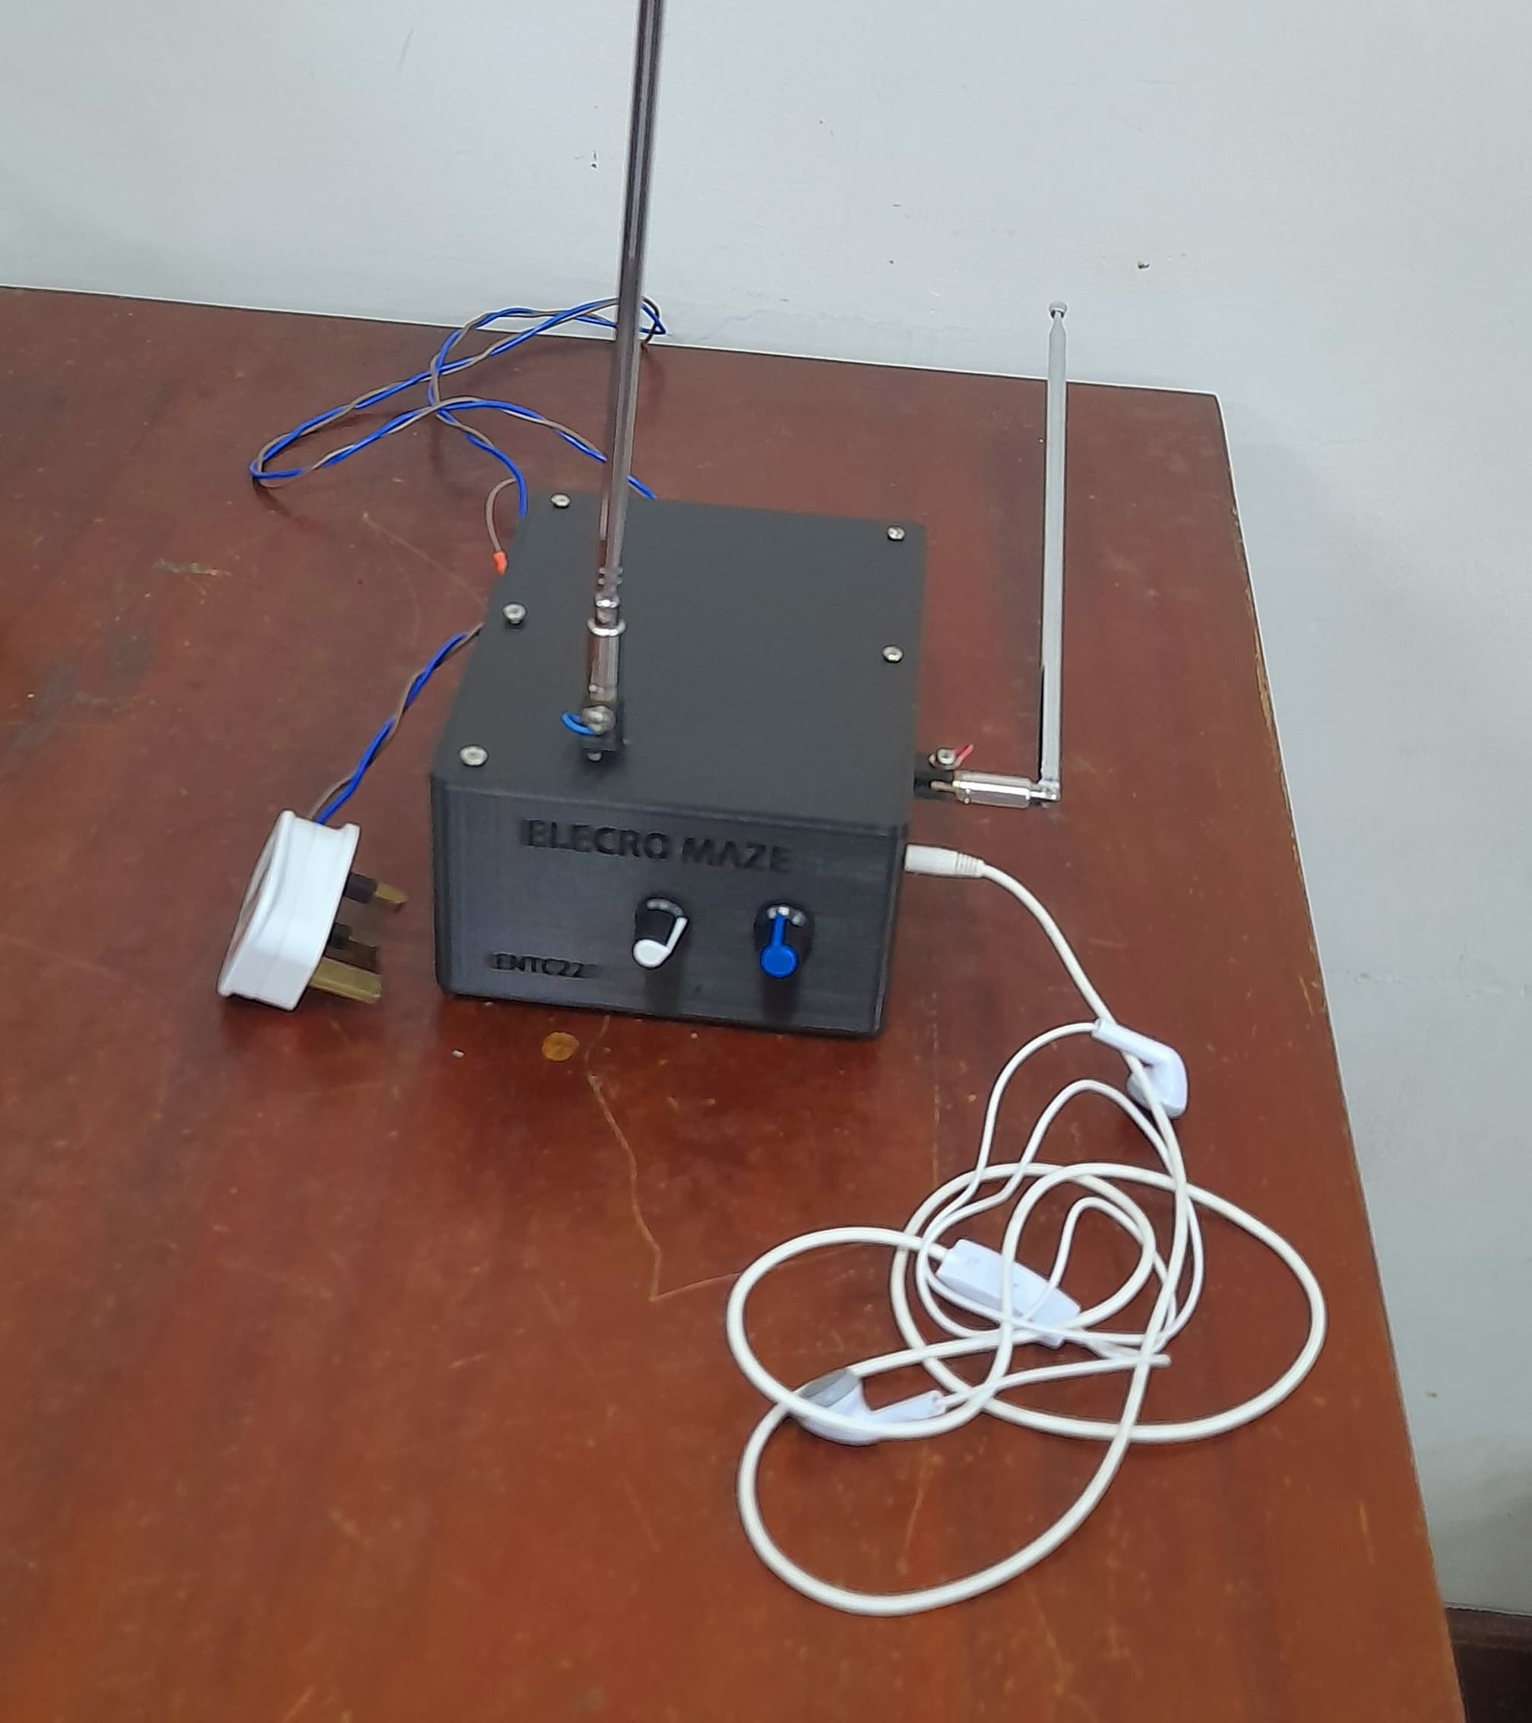
Theremin By ELECTRO MAZE

Slide 2
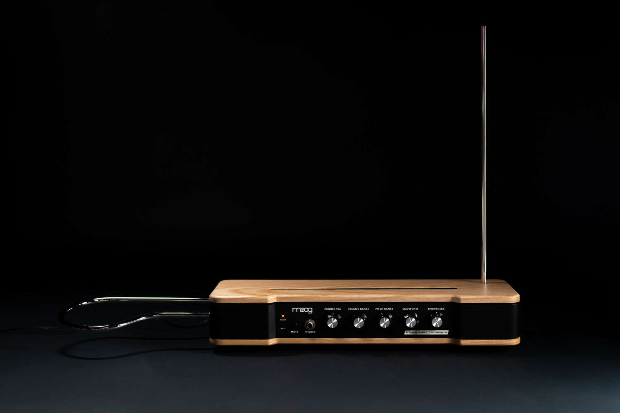

Theremin
by Electromaze

Slide 3
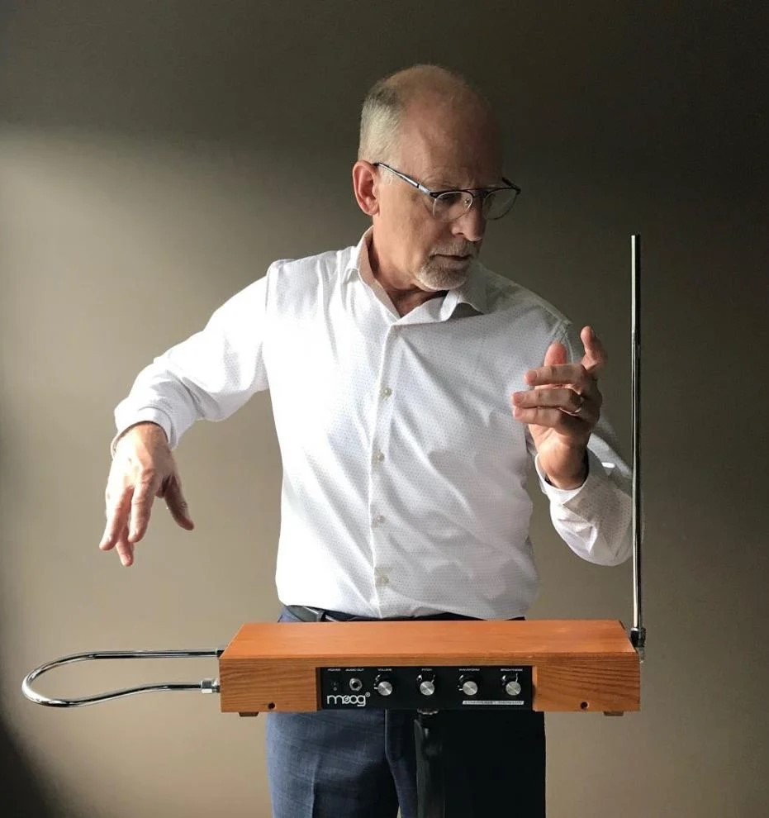
What is Theremin
A theremin is an electronic musical instrument controlled without physical contact. It produces sound based on the movement of the player's hands near two antennas, one for pitch and one for volume.
3

Slide 4
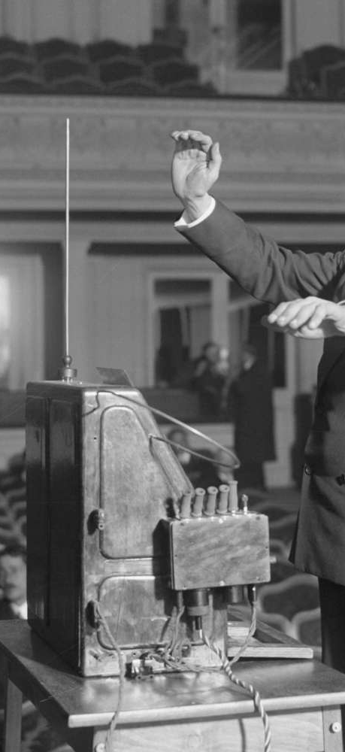
Working Principle
?
Electromagnetic Interaction
Two antennas one for pitch controlling and the other one for volume controlling
Players hands interacts with the electromagnetic fields around the antenna
Oscillator circuits
Theremin has mainly two oscillators.
One is fixed oscillator and the other one changes based on hand proximity.
Pitch and volume
Moving hand closer to the pitch antenna increases the frequency (Higher pitch).
Moving hand closer to the volume antenna reduces the volume (Lower Volume).

Slide 5

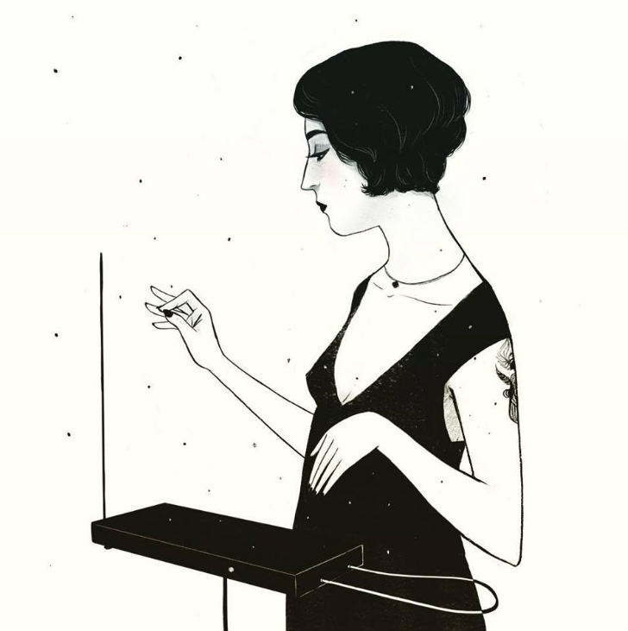
Block Diagram
Volume Oscillator
Envelope
detector
Varying offset
Speaker
Variable Signal Amplifier
Volume antenna
Fixed Oscillator
Audio port
Wave Adder
RC Lowpass Filter
Varying signal
Pitch antenna
Pitch
Oscillator
5

Slide 6
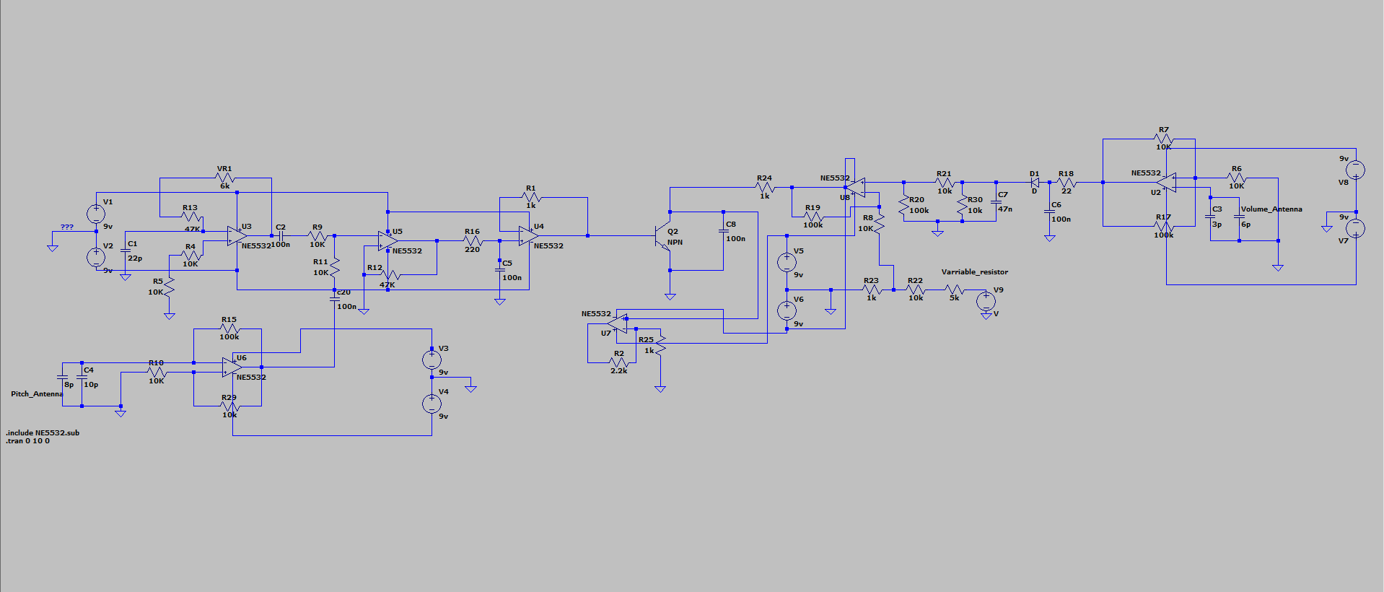
Simulated Circuit

Slide 7
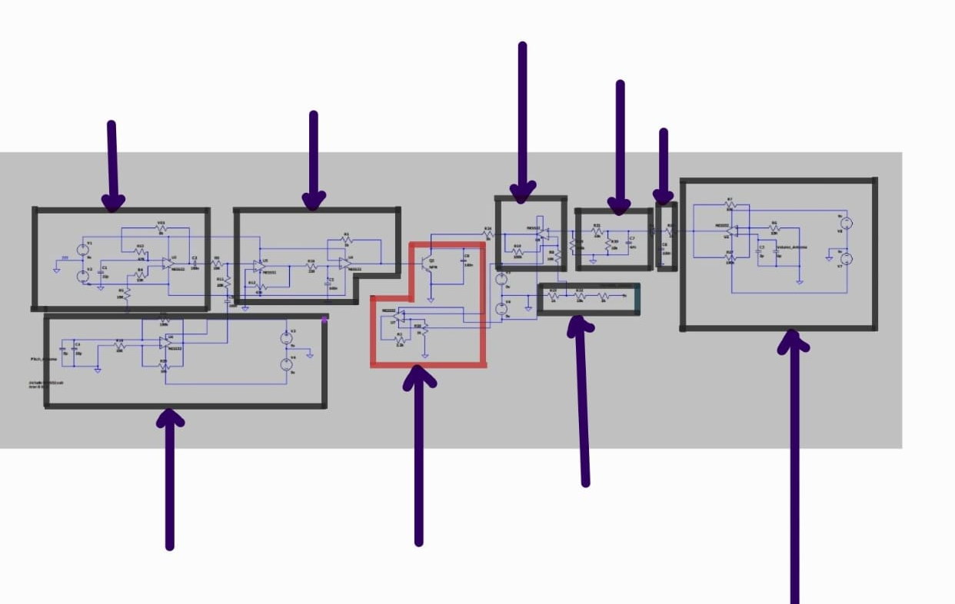
Envelop detector
Subtractor
Fixed Oscillator
Adder
RC low pass filter
Voltage divider
Variable Oscillator​
(Volume)​
Variable Oscillator
(Pitch )
Signal Amplifier

Slide 8
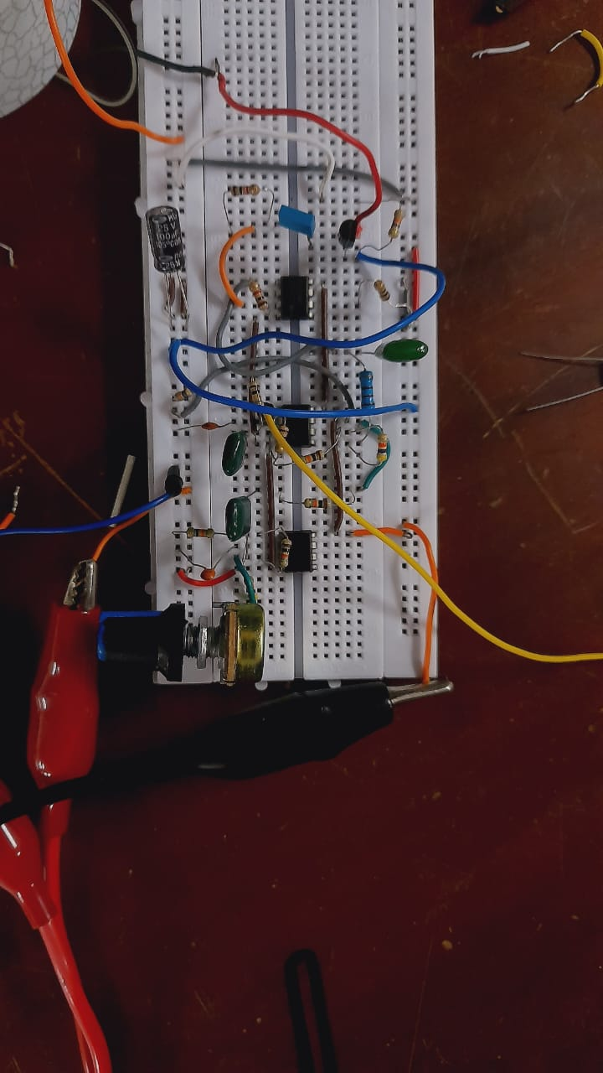
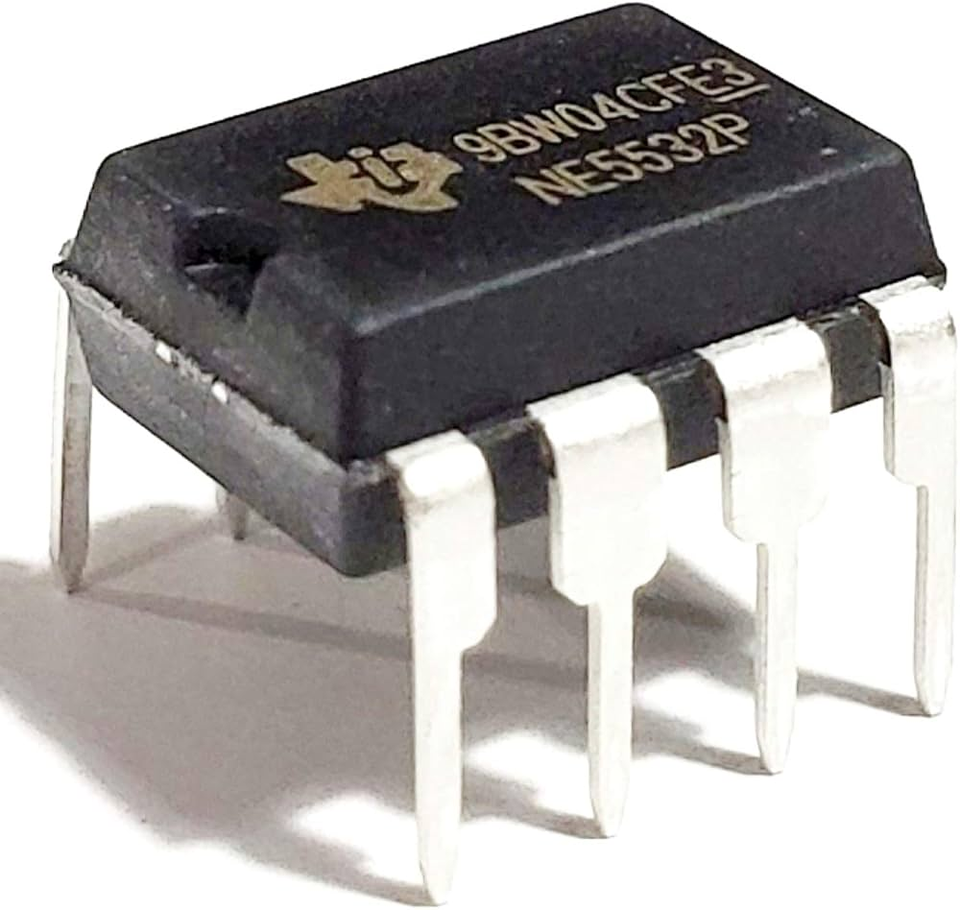
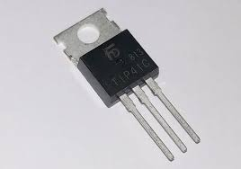
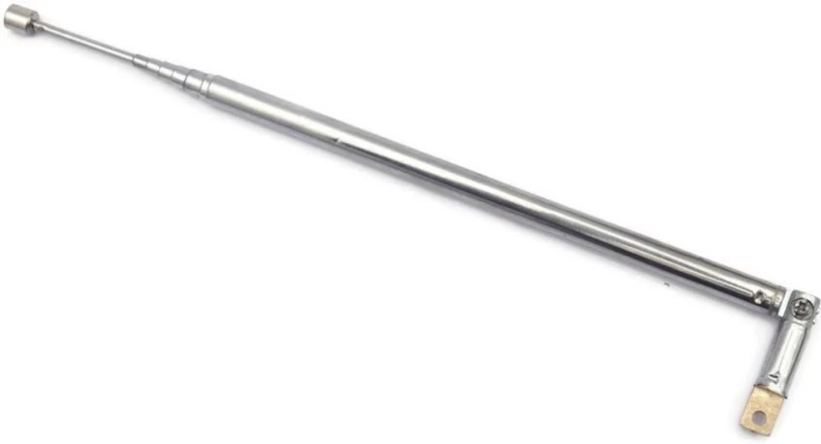
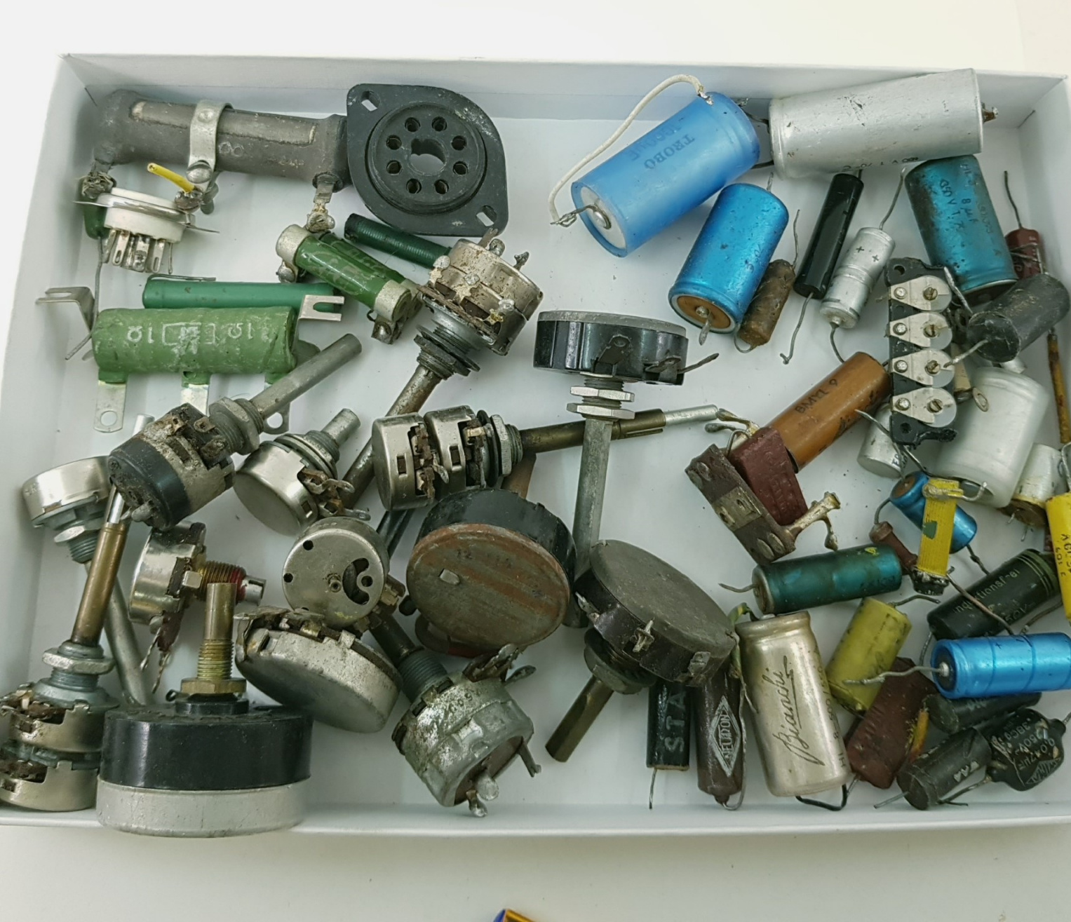
Main Components Used
NE5532P Opamp
Low noise , High frequency
2N2222 Transistor
To power amplify the output sound
Antenna
To take the hand proximity to control the volume and the pitch
Other components
Resistors ,capacitors ,potentiometers

Slide 9
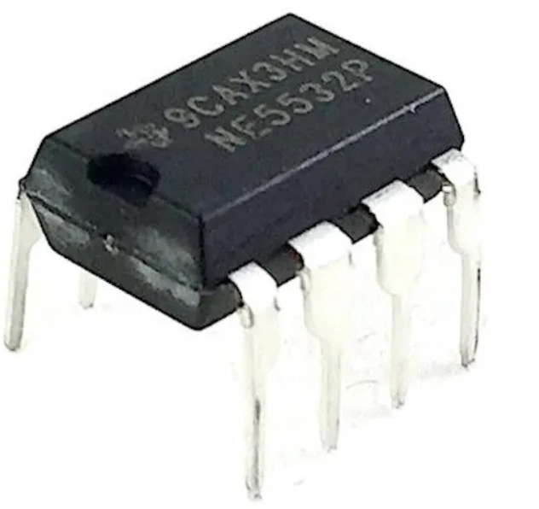
Why NE5532P ?
Low noise
Moderate slew rate
Availability
Low cost
Alternatives and their drawbacks
TL072
Compare to NE5532 Slightly higher noise level and not handle low impedance load
LM358
Limited bandwidth and slew rate
Higher noise levels
LM741
Significantly higher noise and distortion
Compare to NE5532 limited bandwidth and slew rate

Slide 10
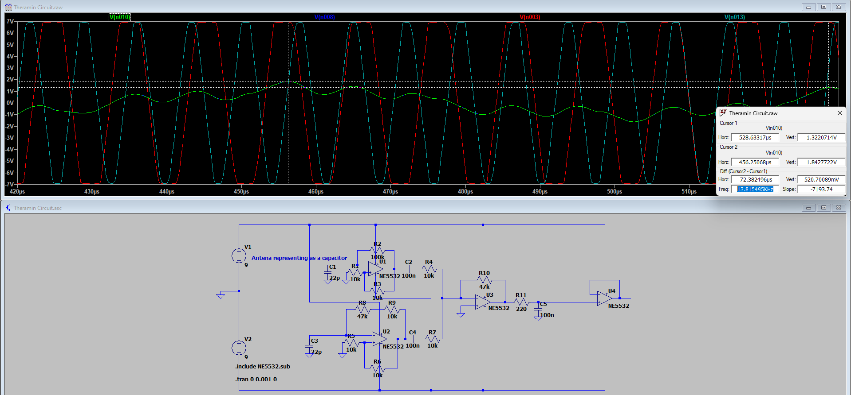

Circuit Simulation

Slide 11
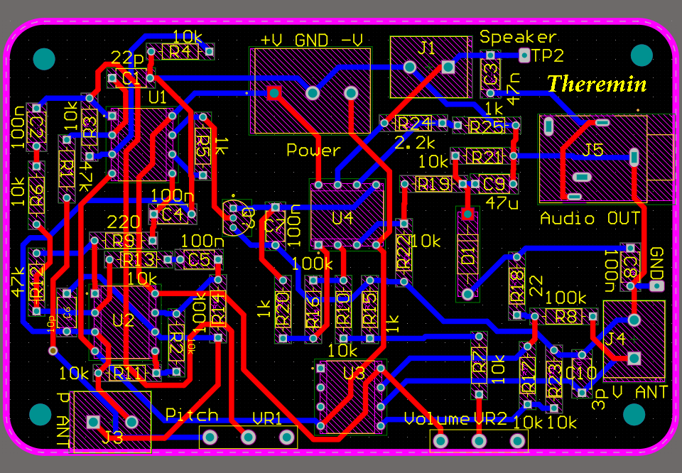
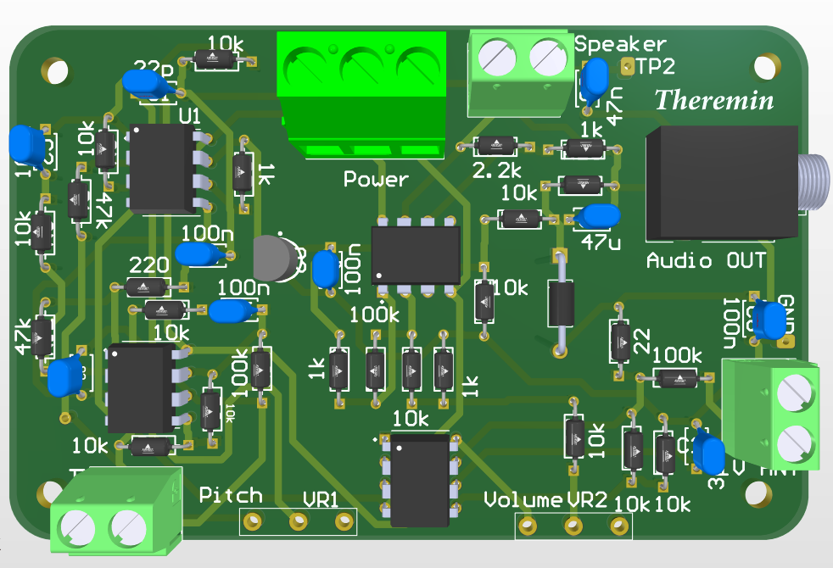
PCB DESIGN

Slide 12
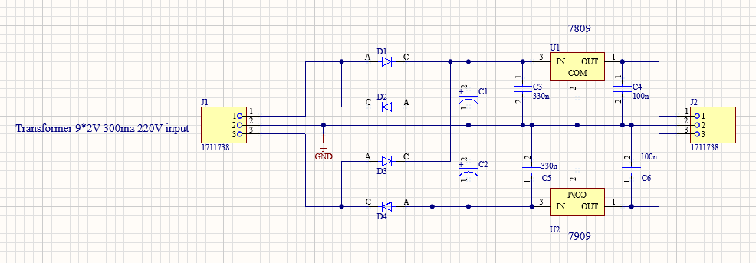
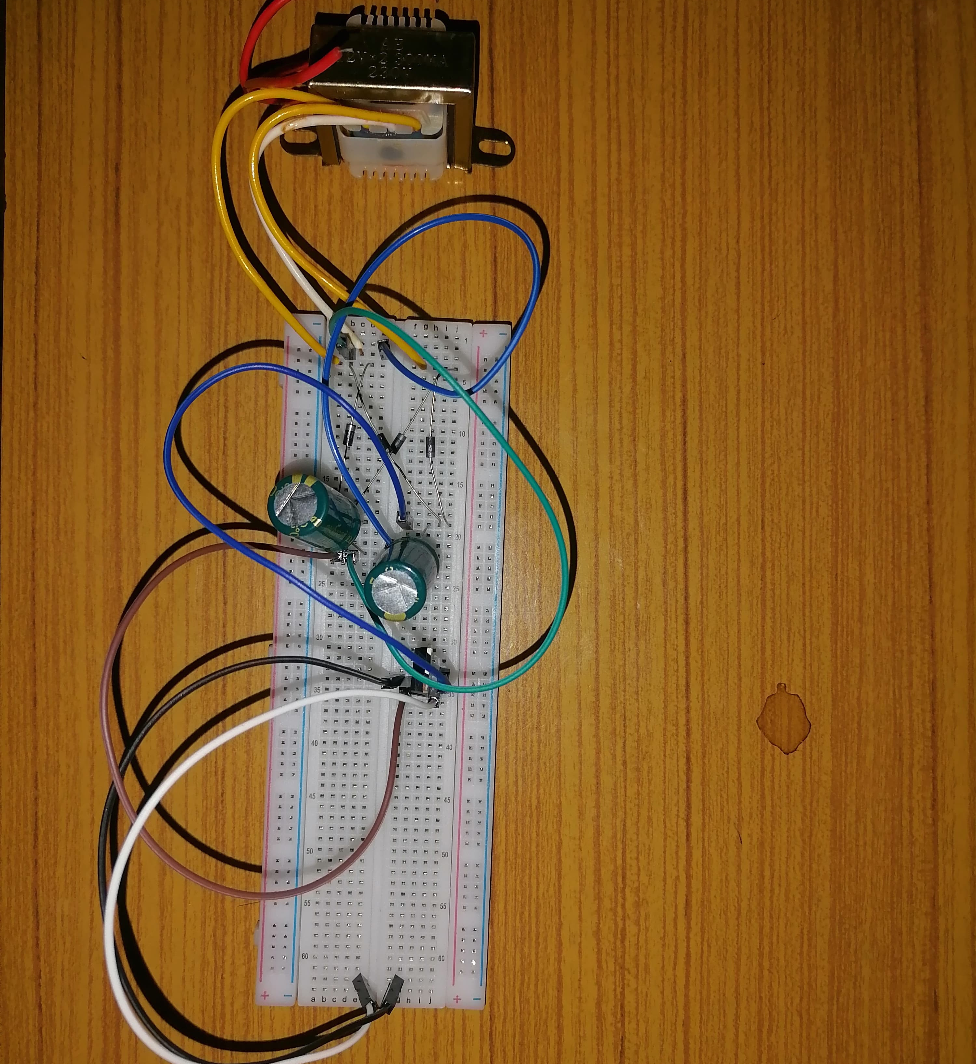
Dual Power Supply

Slide 13
Power Consumption
Maximum - 0.62W
Average – 0.47W
Minimum – 0.46W
0.62W= 9V*(44+25)mA
0.47W = 9V*(32+22)mA
0.46W = 9V*(30+22)mA

Slide 14

Thank You !

